Slide 1


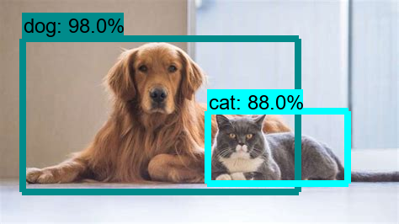
Cat’s And Dog’s Breed Detection And Classification
By: Avinash Nair

Slide 2

About The Project
The Projects Detects and Classifies the Dog and Cat Based on their Breed.
This Model is Capable of Detecting Totally 37 classes I.e.: 15 Cats and 25 Dogs classes.
This can be used by VET to identify the correct breed for treatment.
PROBLEM STATEMENT SOLVED: This Application can be used to identify variety of Cat’s and Dog’s Breed in pet shops by new customers who lacks the knowledge of the breed.

Slide 3

Dataset –used Oxford-Pets Data-set
OVERVIEW OF DATASET
Total Number of Images
4000
2800
Training Size
Validation Size
800
400
Testing Size

Slide 4

Why YOLO?
Fast
Less Prone to Overfitting
Unified Architecture
Process 45 frames per second
Generalized-Representation
Simple Networks

Slide 5
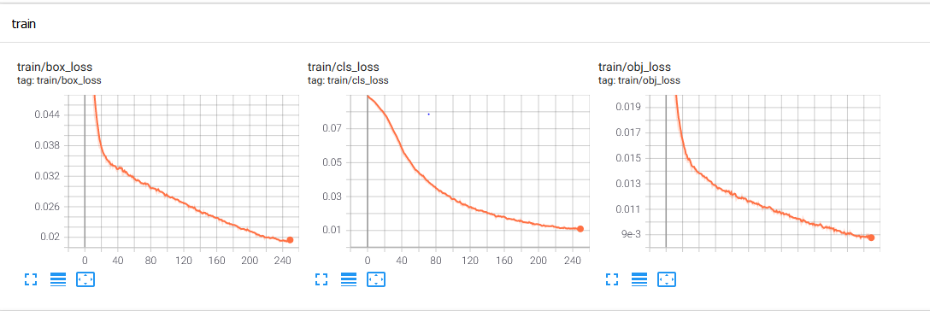
MODEL-SUMMARY
Trained for 250 epoch
Batch size 16

Slide 6
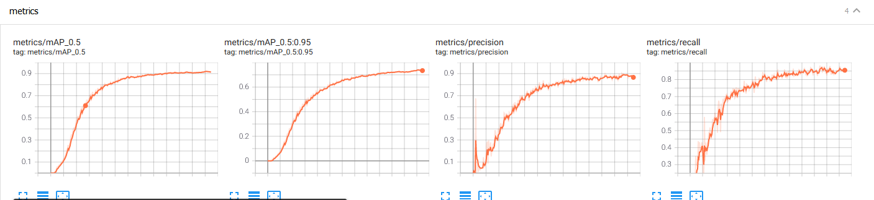
Metrics

Slide 7
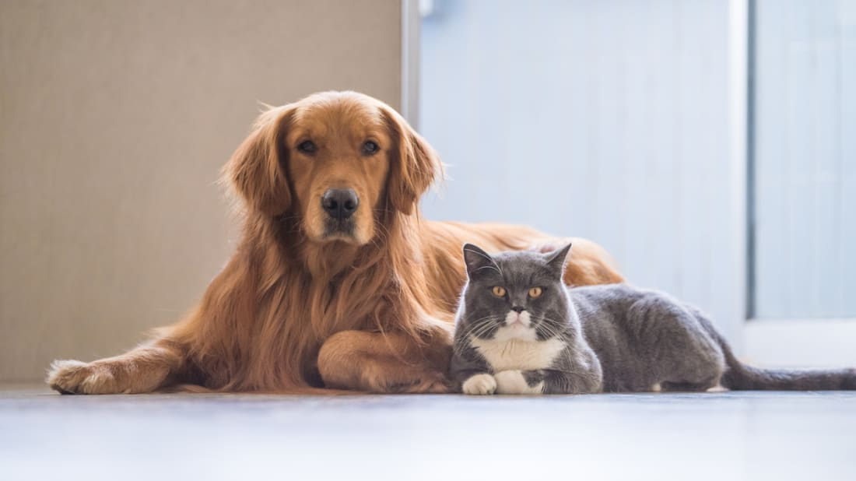
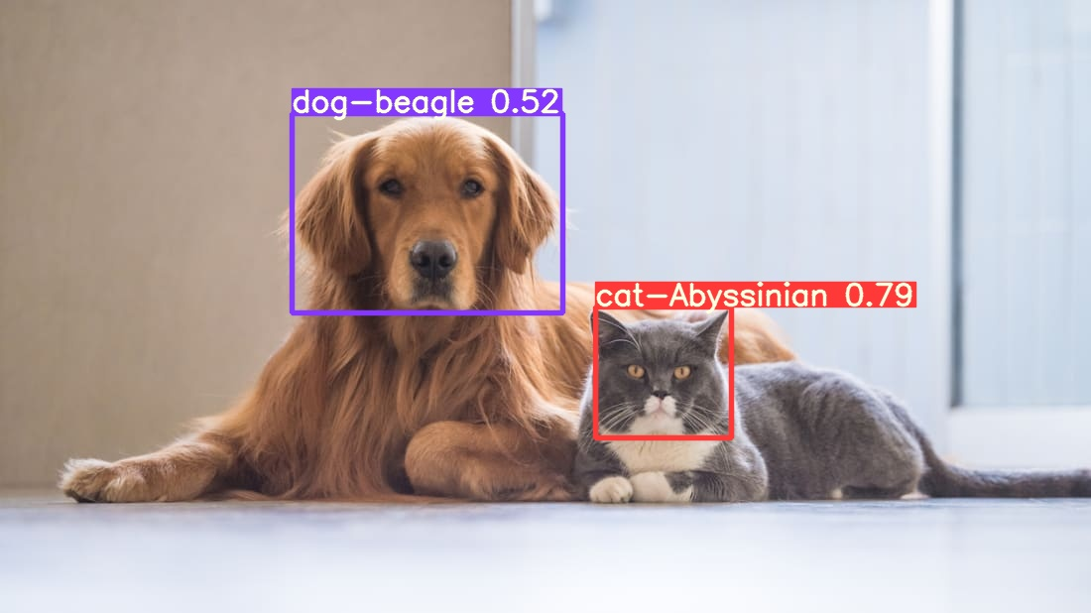
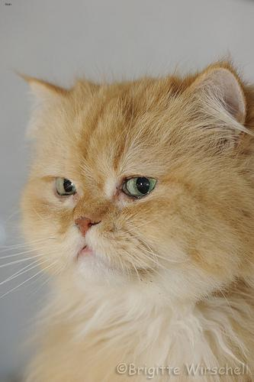
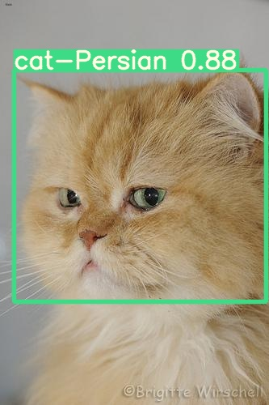
Results

Slide 8

THANK YOU

